Slide 1
SELF SIMILARITY AND QUEUING ANALYSIS OF LTE SYSTEMS
Prem Sujan(170123027)
&
Garvit Mehta(170123018)
Project Guide: Prof. N. Selvaraju

Slide 2
Objective
The main objective of this project is to analyse self-similar property of LTE network traffic to understand burstiness of the network. We also provide a Queuing Model in the context of LTE Networks. We then calculate the hurst parameter for traffic accumulated at several base stations, and simulate M/M/1 queuing system using NS3 to derive its performance metrics experimentally.

Slide 3
M/M/1 Model Performance Metrics
The quality of the service as seen from the customer perspective can be determined by the following metrics
L_{s} is the average number of customers in the system
L_{q} is the average number of customers in the queue
W_{s} is the average time spent by a customer in the system
W_{q} is the average time spent by a customer in the queue

Slide 4
Results
From Little’s law,
W_{s}= L_{s}/λ= (1/µ-λ)
W_{q}= L_{q}/λ= (λ/µ(µ-λ))
It can be observed that
L_{q} = L_{s}ρ W_{q} = W_{s}ρ ,where ρ = λ/µ

Slide 5
Nburst/M/1 model

Slide 6
Need For a New Model
There is an incredible growth in the number of wireless devices such as smart-phones, tablets and Internet of Thing (IoT) .
In addition to the fast development of media streaming applications, IPTV, telemedicine and Internet gaming have led to a significant challenge to the design and deployment of cellular technology.
Investigating and analyzing the distribution of data generated by each device in LTE network should be the most important factor to estimate the quality requirements and capabilities of LTE networks.

Slide 7
Required Properties for an appropriate model
The main difference from the standard models is the requests in telecommunication networks don’t follow a distribution rather come in a continuous bursts.
The unpredictable traffic must be both bursty and self-similar.
Many models like M/G/1 queue with changing parameters, batch-arrival model, continuous burst flow models failed to mimic the traffic in telecommunication networks.

Slide 8
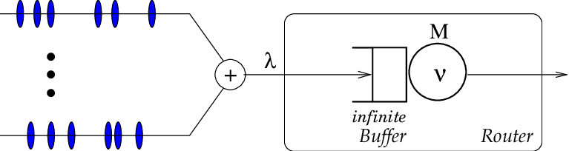
The packet generated by each user arrive at a single queue which is maintained by a Router.

Slide 9
Describing Network Queue
The number of packets requested by a mobile device is considered as a random variable.
The properties and distribution of this random variable is purely based on the mobile application used to request the data.
This is the reason standard queuing models are not appropriate to understand telecommunication systems.

Slide 10
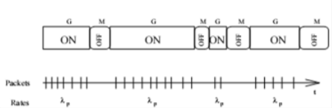
Describing Network Queue
N Burst Model is one of the variants of ON-OFF models
The arrival process of N-Burst is the superposition of N ON-OFF type identical and independently distributed source's traffic streams.

Slide 11
Essential parameters of Model
𝜿 : average rate of packet arrival for each source.
λ: The overall arrival rate that is produced by N sources i.e. λ = 𝜿 N
λp: the peak transmission rate during a burst i.e. at ON time.
λb: Mean burst arrival rate =λ/Nb.
Nb: Average number of packets during a burst (at ON period)
ON : the average time during which the node is active
OFF : the average time during which the node transmission is OFF.

Slide 12
SELF SIMILARITY

Slide 13
Self Similarity
Self-Similarity is the property we can associate with an object whose appearance remains same irrespective of the scale at which it is viewed.
Self similarity is used in the distributional sense in the case of stochastic objects like time series: the object’s correlational structure remains unchanged when presented at different scales. As a consequence, at a variety of time scales, bursts in a time series.

Slide 14
Self Similarity
Since LTE technology is rapidly expanding in terms of coverage and user base, it is essential to investigate its network traffic
A bursty traffic can be described statistically using self-similarity. Since bursts are observed on all time scales, traffic at certain time are generally correlated with traffic at a future time.

Slide 15
Self Similarity
For a time series X = (X_{t} : t = 0, 1, 2, ....), the m aggregated series is given by X^{(m)} = (X^{(m)}_{k} : k = 0, 1, 2, ....) by summing the original series X over non-overlapping blocks of size m.
If X is self similar, it has the same auto-correlation function r(k) = E[(X_{t} − µ)(X_{t+k} − µ)] as X^{(m)} for all m.

Slide 16
Self Similarity
Self-similar time series shows long-range dependence, r(k) ∼ k ^{−β} as k → ∞ where 0 < β < 1.
Self similarity is expressed using a single variable, representing the speed of decay of autocorrelation function known as Hurst parameter H = 1−β/2. For self similar series 1/2 < H < 1, when H → 1, degree of self-similarity increase.

Slide 17
Existence of Self Similarity
There are several arguments made by researchers about why the Internet traffic is self-similar ranging from file size distribution on web servers, ON/OFF models of heavily tailed distribution, user behavior, network protocols, buffer in routers and the TCP congestion avoidance algorithms.
Extensive statistical analysis shows that the data at the level of user equipment or source-destination pairs are self-similar and exhibit high variability.

Slide 18
Effects of Self Similarity
When traffic increases in a self-similar network, the bandwidth and buffer sizes can’t handle the bursts, resulting in packet loss, implying financial loss for network operator.
Packets are sent again which again leads to congestion and wastage of resources.

Slide 19
Effects of Self Similarity
Predictive feedback control method uses dynamic traffic flow control, by adjusting congestion based on either nodes have on-set of concentrated periods of high or low activity.
Error correction method uses re-transmission of non viable data like streaming audio or video. The level of redundancy is adjusted according to the congestion level. This method has the risk of damaging the congestion level due to high traffic from these nodes

Slide 20
Hurst Parameter
The Hurst parameter, also known as the Self-Similarity parameter, is a measure of time series long-term memory.
A time series with a value H in the range of 0.5-1 has long-term positive autocorrelation.
A value in the range of 0-0.5 means the time series has long-term swapping between high and low values in adjacent pairs.

Slide 21
Calculating Hurst Parameter
There are a number of methods to calculate hurst parameter like, Variance time plot, R/S plot.
We used Variance-time plot to estimate H, For a self-similar process, the variance of the aggregated time series follows ,
Var(X ^{(m)} ) ≈ Var(X)/ m^{β}

Slide 22
Calculating Hurst Parameter
Taking logarithm on both sides give us,
log[Var(X ^{(m)} )] ≈ log[Var(X)] − βlog(m)
Since Var(X) is constant, if we plot Var(X^{(m)} ) and m on log-log plot, we should get a straight line with slope −β
Plugging this value in H=1-β/2 give the hurst parameter

Slide 23
Traffic analysis

Slide 24
Data collection
We used traffic of 4G cell towers traffic data to study self-similarity of the network.These cell towers serve user equipment in their vicinity. When a user makes a data service request, that device will be served by a 4G cell closest to the user. The traffic of a cell within an hour is given by the data capacity of all devices served by the station.
Example: Cell X is serving 30 subscribers, assuming if a customer on average uses 20Mb per hour. Traffic of cell X that hour = 30 * 20 = 600Mb.
We will see that the nature of traffic varies from time to time, there is peak traffic around 10-12 AM and 11-12PM, and low traffic is observed during early hours of the day

Slide 25
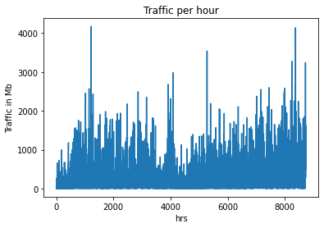
Traffic analysis
Data consists of 50 cells collected over 1 year x 24 hours x 50 cells.
We will see that the nature of traffic varies from time to time
The data of one of the cells is represented here. The y-axis represents traffic accumulated at a eNode base station in Megabytes per hour over 1 year time frame.

Slide 26
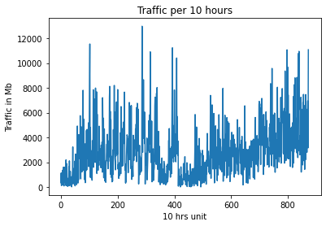
Traffic analysis
Next, we aggregate the traffic accumulated per 10 hours by summing the 10 non-overlapping consecutive traffic per hour.
This is represented with X⁽¹⁰⁾
We aggregate for different values of m, to calculate H.

Slide 27
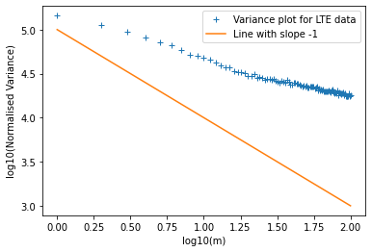
Variance time plot
We use the data presented above to calculate Variance of X^{(m)} for all m ranging from 1 to 100 and plot log(Var(X^{(m)})) vs log(m)
The blue cross points represent the log of variance of aggregated time series and the log of aggregation size, the red line represents a line with slope -1

Slide 28
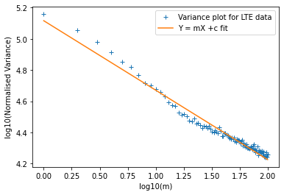
Variance time plot
To calculate the slope we use linear regression to fit the data points along a line,
The plotted curve is fitted with a Y=mX+C curve with best fit slope of -0.44535 and y-intercept of 5.11624
⇒ −β = −0.44535 ⇒ H = 1 − β/2 =1−(0.44535)/2 = 0.777325

Slide 29
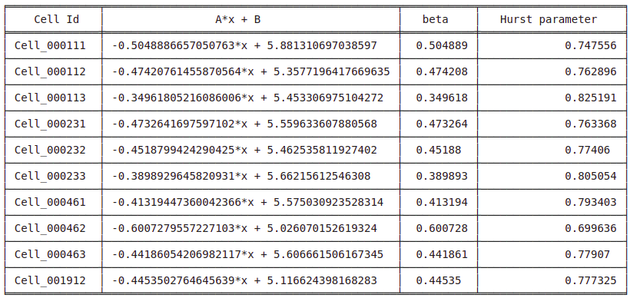
Hurst parameter for different base stations
We take data from more eNode base stations and verify the self-similarity of the traffic using the same method as above, the results of the fit and hurst parameter are given below

Slide 30
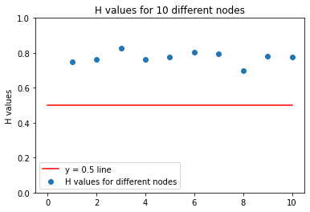
Hurst parameter for different base stations
We can see that the Hurst parameter is well above 0.5 indicating the traffic in LTE network is self similar, implying the burstiness in the data requests

Slide 31
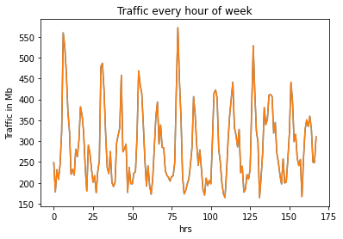
Hourly traffic in a week
Traffic of all hours in a week are averaged in the data and is plotted below.
The data points start from Wednesday hour 0, and include traffic for each hour upto an year. We can observe that the traffic in the early hours of the day is much less compared to the peak traffic observed within a day.

Slide 32
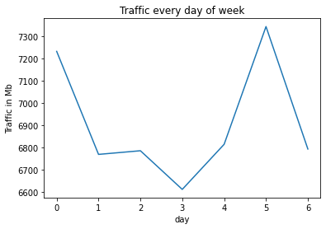
Daily traffic in a week
Traffic of all days in a week are averaged in the data and is plotted below.
We can observe that the traffic is more during Wednesdays and Mondays, which is generally true for internet traffic as well.

Slide 33
M/M/1 Simulation

Slide 34
NS3 Simulator
NS-3 is a discrete-event network simulator, targeted primarily for research and educational use.
NS3 is used to simulate modern network systems with real time scheduler many used for academic and research purposes.

Slide 35
Model Implementation
It can take inputs like lambda referring to arrival rate, mu referring to service rate, initial packets referring to number of packets in queue initially, numpackets referring to number of packets to en-queue, queue limit referring to size of the queue.
The packets are enqueued according to the arrival rate and dequeued according to the service rate.
All activities are logged and traces are stored.

Slide 36
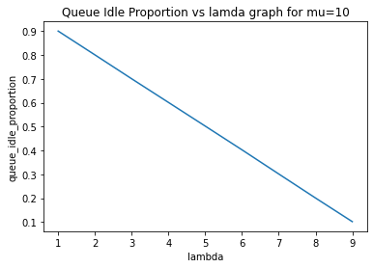
Increasing lambda linearly decrease the idle proportion of the queue linearly following the formula P(idle) = 1 - ⍴ρρ

Slide 37
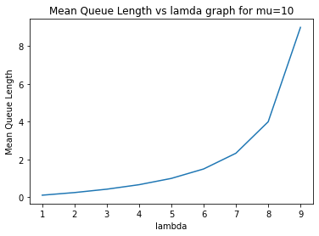
Length of the system in steady state is consistent with the given by the formula: L_{s} = ⍴/(1-⍴)

Slide 38
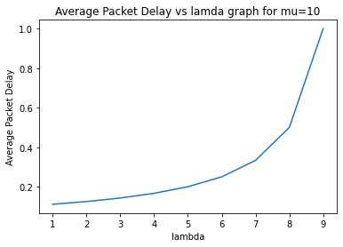
Mean Delay of packets is consistent with the formula W_{s} = L_{s}/λ = 1/(μ-λ)

Slide 39
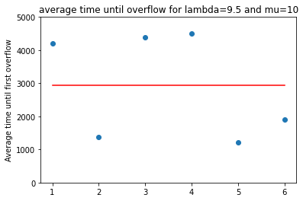
Buffer Overflow for
λ = 9.5 and μ = 10
The individual points represent the times at which the queue overflowed for the first time for different simulation.
The horizontal line represents the average of the overflow times of these simulations.

Slide 40
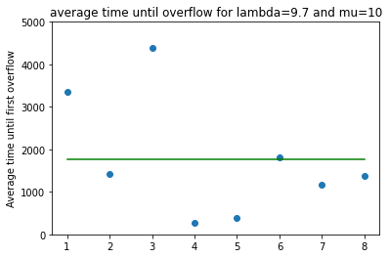
Buffer Overflow for
λ = 9.7 and μ = 10
The individual points represent the times at which the queue overflowed for the first time for different simulation.
The horizontal line represents the average of the overflow times of these simulations.

Slide 41
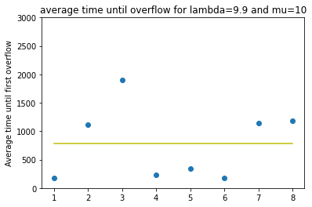
Buffer Overflow for
λ = 9.9 and μ = 10
The individual points represent the times at which the queue overflowed for the first time for different simulation.
The horizontal line represents the average of the overflow times of these simulations

Slide 42
Overflow times as λ approaches μ
the average time until first overflow decreases with λ value coming close to μ.
this behaviour is expected as the increased arrival rate congest the queue faster and probability of a packet dropped from the queue increase at lower times.

Slide 43
Summary and Conclusions

Slide 44
Summary
We understood the basic performance metrics of queuing systems like mean length of queue/system, mean waiting time in a queue/system.
We studied Nburst/M/1 model which takes into consideration of the burstiness of the packet arrivals in the network.
We studied about self-similarity and see why an LTE network has self-similarity.
We calculated Hurst parameter to determine the degree of self similarity

Slide 45
Summary
We analyse a data set consisting of network trace at 4G cell stations which is collected over a certain time period and we use Variance-time plot to determine the Hurst parameter of the network traffic, this is done for several datasets.
We implemented M/M/1 queue model in ns3 simulator and verified the previously studied results by plotting idle time proportion of the queue, mean length of the queue, mean delay of the packet for varying arrival rates.
We also saw buffer overflow results for M/M/1 queue

Slide 46
Conclusions
Since the calculated Hurst parameters for the analysed LTE dataset are close to 0.8 which is greater than 0.5, we proved that the LTE network traffic is self-similar ,and hence bursty in nature.
So we can conclude that Nburst/M/1 model is a suitable model to analyse LTE networks.

Slide 47
Thank You

